Slide 1

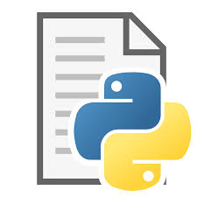







Monitor games for goals
Update script; kill existing process, restart
Call automation via webhook when goal scored
Code sync’d to github
Flash goal light
Call webhook to pull latest
Call smart switch
Listen for git commits

Slide 2


# Flask webhook listener
# systemd for starting goal_tracker
# systemd for auto restart of flask webhook listener
Play goal horn
Monitor games for goals
Update script; kill existing process, restart
Code sync’d to github
Call automation via webhook when goal scored
Flash goal light
Call webhook to pull latest
Toggle smart switch
Listen for git commits

